Slide 1



Done By: Roshini P Shanjana P Narmadhaa S Nisha K

Slide 2




Introduction About Us
What is Flight Booking application The Project
Workflow
ER diagram
Technology stacks we have used The Implementation part
The Execution part Conclusion

Slide 3






This Flight Booking APP is the ultimate digital platform designed to revolutionize the way you book flight tickets. With this app your flight
travel experience will be elevated to new heights of convenience and efficiency.
Our user-friendly web app empowers travelers to effortlessly discover, explore, and reserve
flight tickets based on their unique preferences.

Slide 4

About Us
1990
1990s - Emergence of Online Travel Agencies (OTAs):
2000
Late 1990s to Early 2000s - Rapid Growth and Consolidation:
2024
Mid-2000s to Present - Innovation and Diversification:

Slide 5



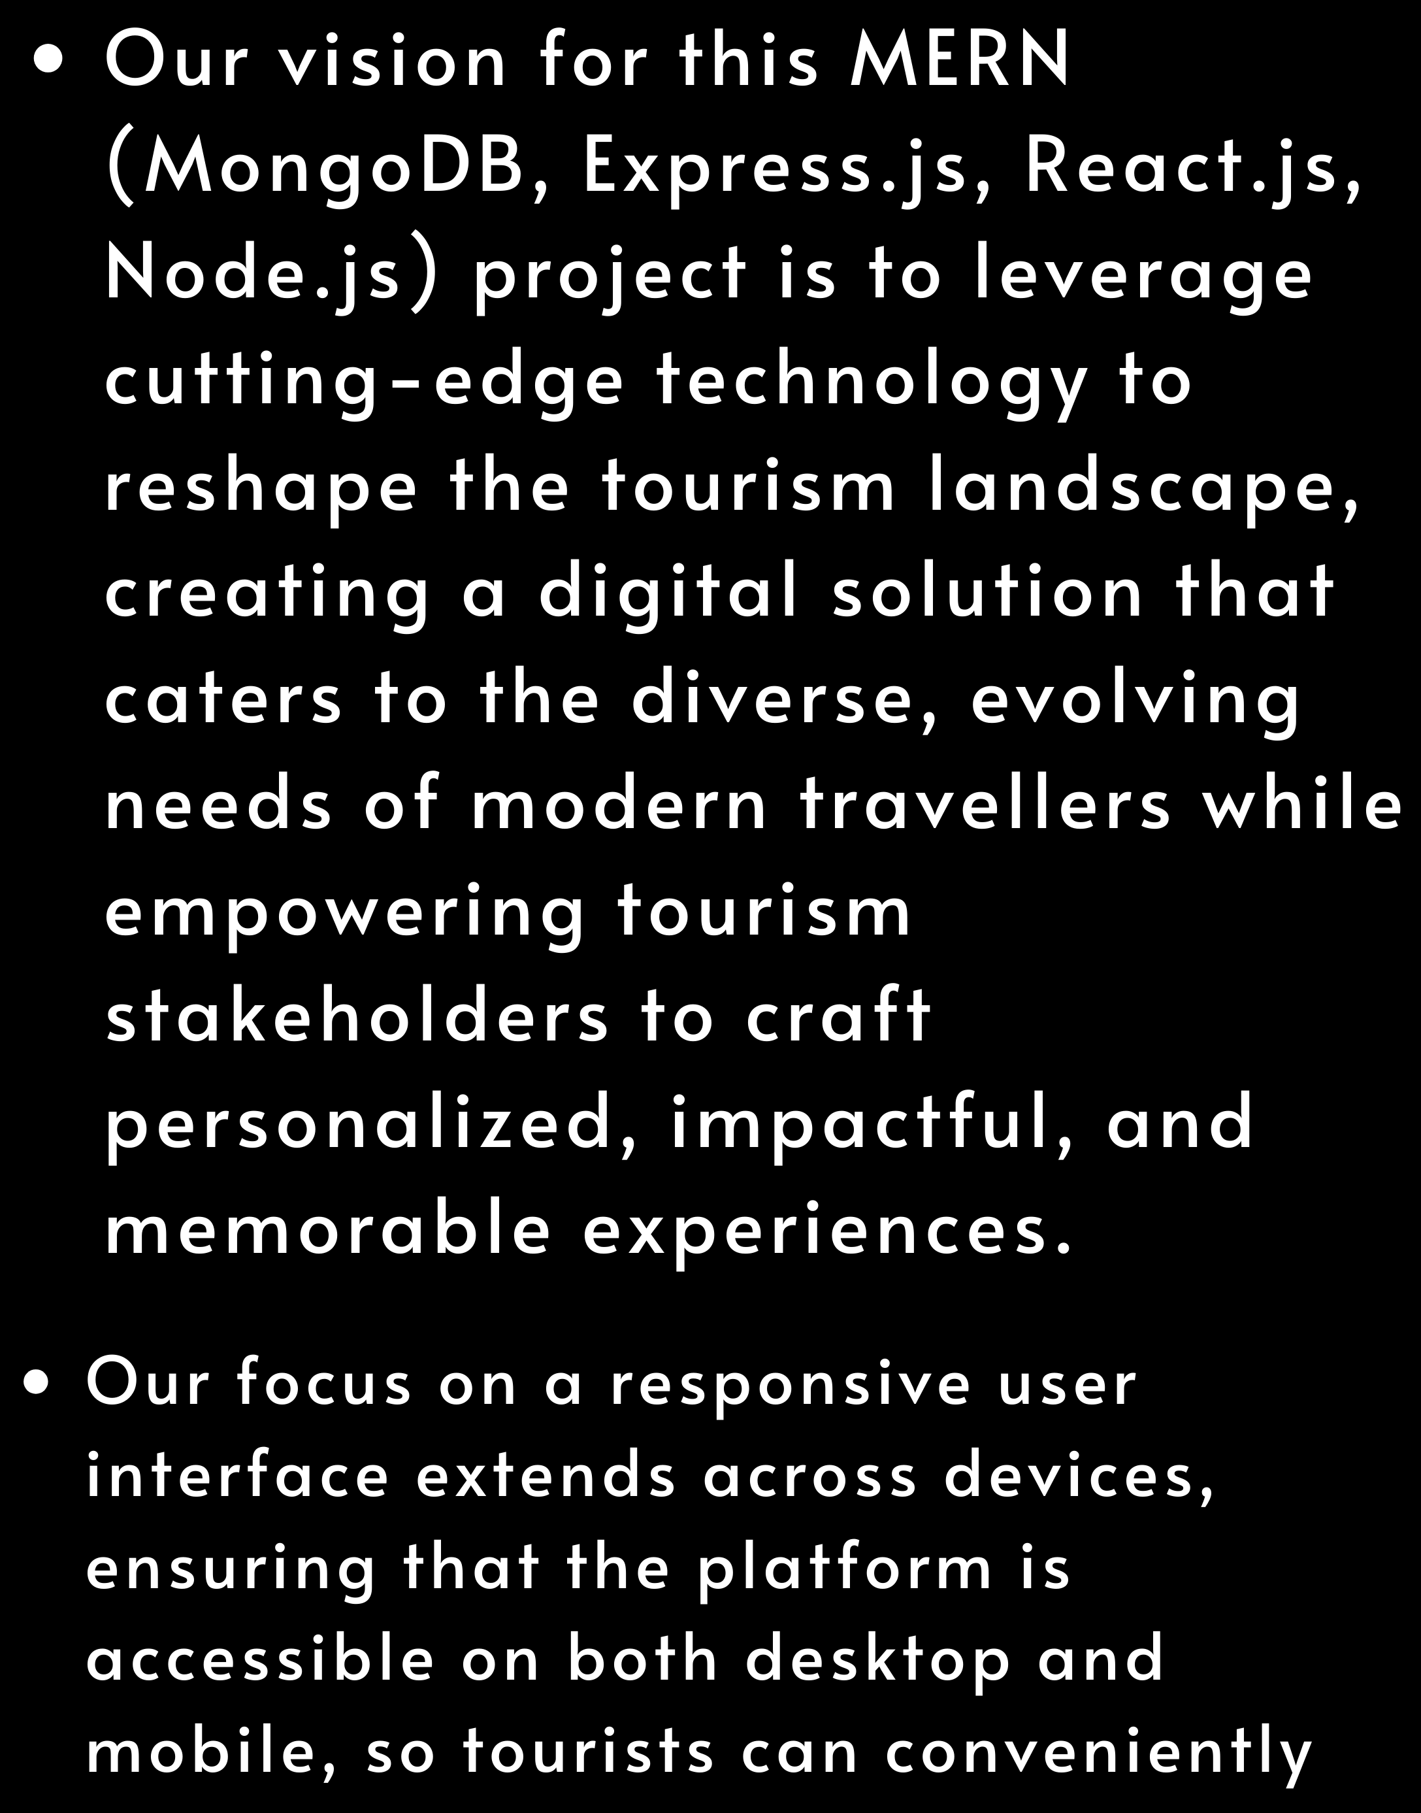
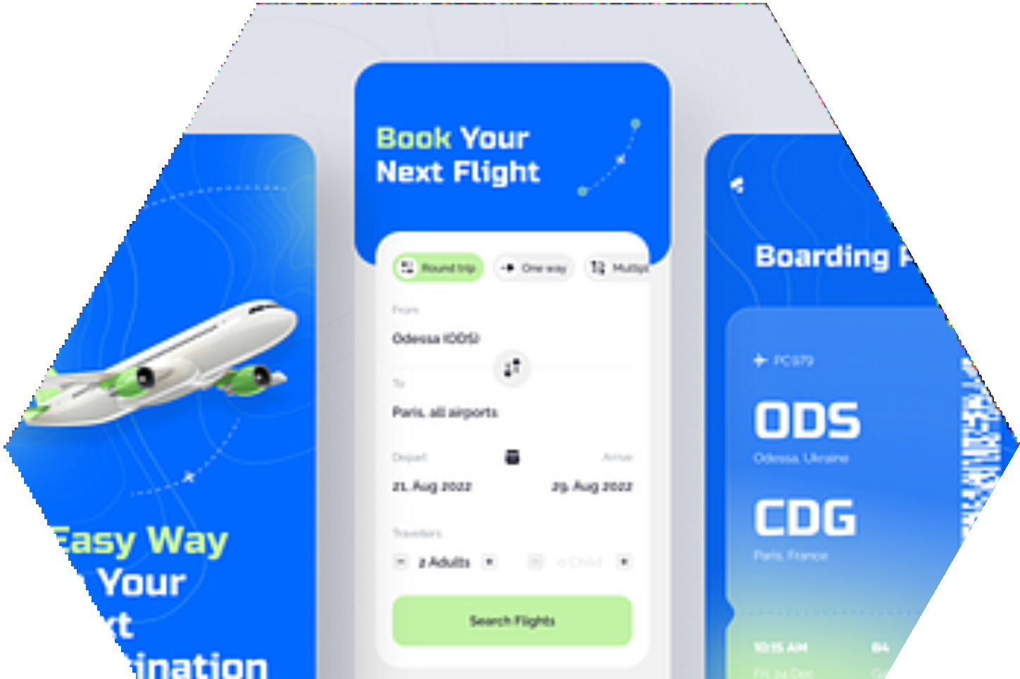



Slide 6


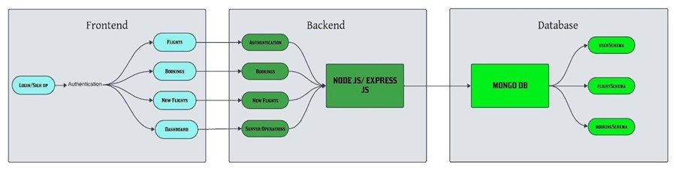

Slide 7





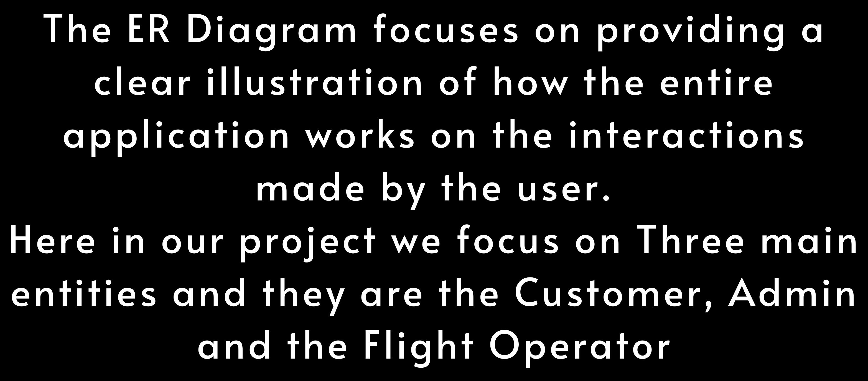




Slide 8





Admin
Customer
Flight Operator
Role of Flight Operator:
The Flight Operator focuses on analyzing how many bookings have been done and at the same time they
can update any of the user’s information.
Role of the Customer: The Customer is the one who focuses on booking any flights
and cancelling them. They can just interact with the application.
Role of the Admin:
The Admin focuses on analyzing the number of cancelled and
booked tickets done by the user.

Slide 9
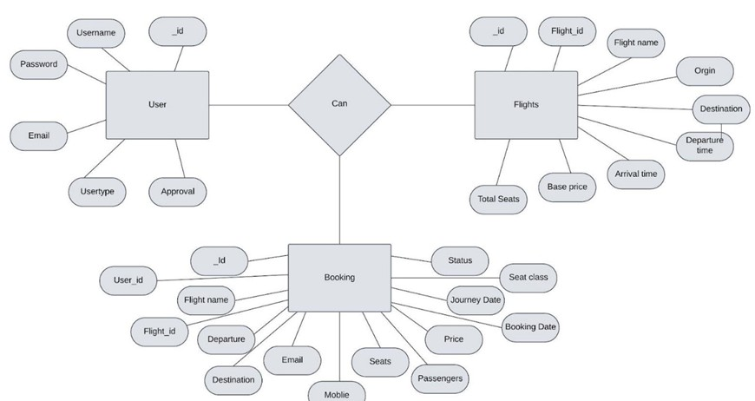

Slide 10





Slide 11


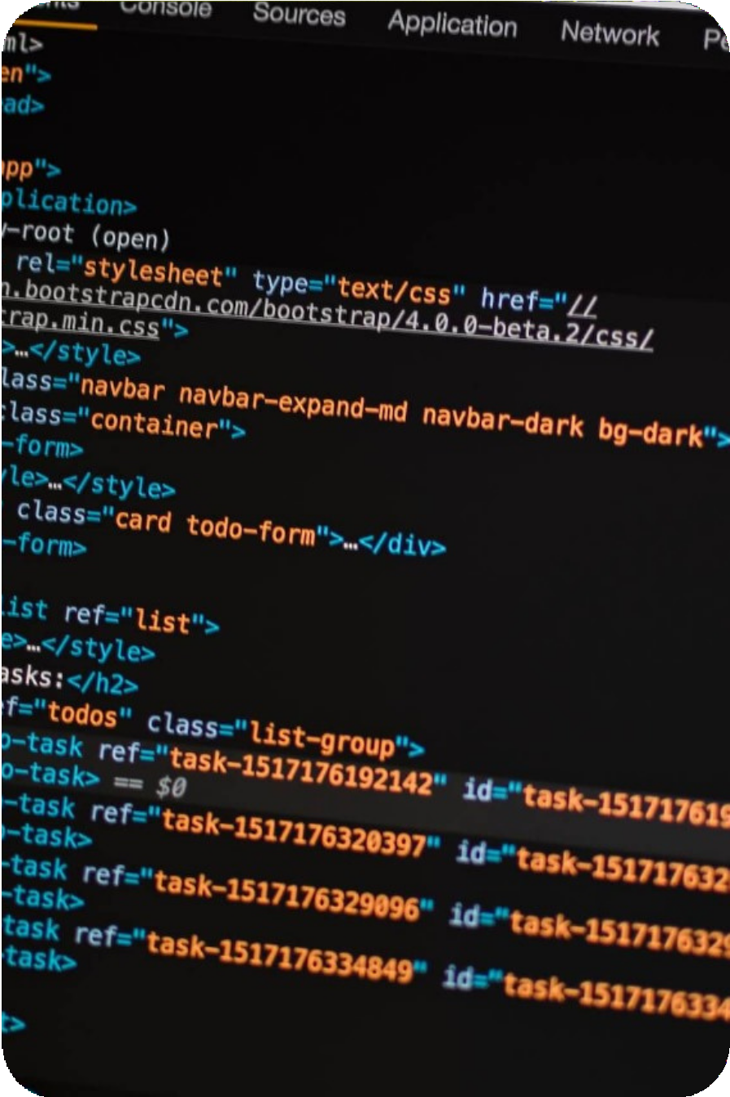


1. Frontend Technologies:
React.js: Used to build an interactive and dynamic user interface. React enables efficient rendering and smooth user interactions.
Bootstrap: Provides responsive design and pre-styled components for faster and visually appealing UI development.
Axios: Handles HTTP requests to the backend, facilitating smooth data fetching for flight information, user authentication, and booking actions.
React Router: Enables navigation across different pages (such as flight search, booking, and user profile) without page reloads, providing a seamless user experience.

Slide 12

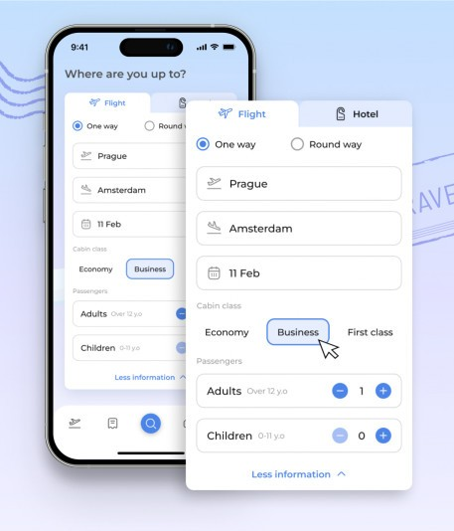

Backend
In a flight booking application developed with the MERN stack (MongoDB, Express, React, Node.js), backend technologies handle data management, business logic, and API requests. MongoDB stores flight, booking, and user data in a flexible schema, allowing for efficient queries. Express.js, running on Node.js, manages API routes, handling requests such as searching for flights, booking seats, and user authentication. Node.js handles server-side operations, processes data, and interacts with MongoDB to retrieve or update records as needed.
This backend setup enables efficient communication between the frontend and database, providing real-time updates and a smooth booking experience for users.

Slide 13
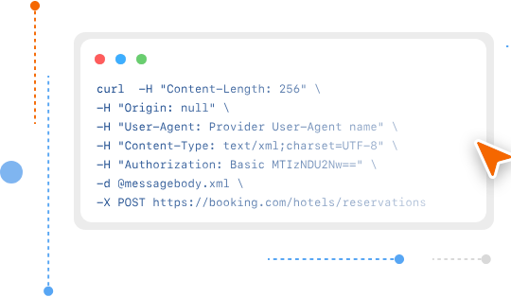
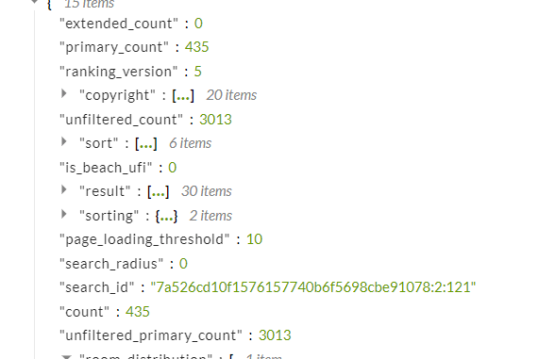
APPLICATION PROGRAMMING INTERFACE
In a flight booking application, APIs play a crucial role in managing interactions between the frontend and backend. The backend API, built with Express.js on Node.js, exposes endpoints that handle requests like flight searches, booking confirmations, and user authentication. These endpoints allow the frontend to send requests for data, such as available flights or seat availability, and perform actions like reserving seats or retrieving booking details. Each API request processes and validates input, interacts with the MongoDB database, and sends a structured response back to the frontend. This setup ensures a secure, organized flow of data, providing users with real-time updates and reliable booking functionalities.

Slide 14

Role of JWT Token
Step-by-Step Example in a Flight Booking Application
User Login
User enters their login credentials.
Server validates credentials and issues a JWT containing the user’s ID, role, and possibly other claims (e.g., iat for issue date, exp for expiration date).
Token Handling
The client stores the JWT securely (e.g., in a cookie with HTTP-only and Secure flags for web apps).
For future requests (e.g., viewing a booking or making a new booking), the client attaches the JWT to the Authorization header.
Verifying the Token on Each Request
The server verifies the token’s authenticity and checks for expiration.
If the token is valid, the server retrieves user details from the token payload, such as the user’s role (passenger or admin) to apply role-based access control.
Access Control in API Endpoints
Only specific users can access certain endpoints. For example:
Booking management endpoints require a valid passenger token. Flight management or data analysis endpoints require an admin token. Why JWTs are Ideal for a Flight Booking Application
Stateless Authentication: With no need to store session information on the server, JWTs make it easy to scale the application. Enhanced Security: JWT signatures help prevent tampering, and expiration times minimize risks in case of token theft.
Role-Based Access: JWTs facilitate role-based access control, allowing passengers, admins, and airline staff to have secure, role-specific permissions.

Slide 15
The Implementation Part

Slide 16
The implementation part focuses on developing the best user interface, the best server experience and also to provide the data based on the searches made by the user.
THE FRONTEND PART
COMMAND 1: npm install vite@latest ./ COMMAND2: npm install @testing-library/jest-dom
@testing-library/react @testing- library/user-event axios bootstrap react react-dom react-router-dom react-scripts vite web-vitals COMMAND 3: npm start
THE BACKEND PART
COMMAND 1: npm init -y COMMAND2: npm install bcrypt body- parser cors express mongoose COMMAND 3: npm install nodemon -g COMMAND 4: nodemon index.js
THE DATABASE PART
The database part focuses on connecting the database to the server.
For this, we have focused on connecting the MongoDB Atlas cluster Connection string into the MongoDB compass. Alternatively, we have also focused on installation of Mongodb for VS code and then, we have entered our connection string on connecting to the database.
THE API PART:
Define API Endpoints Set Up Express Routes
Implement CRUD Operations Data Validation
Error Handling
JWT Authentication and Authorization Testing API Endpoints

Slide 17


Slide 18

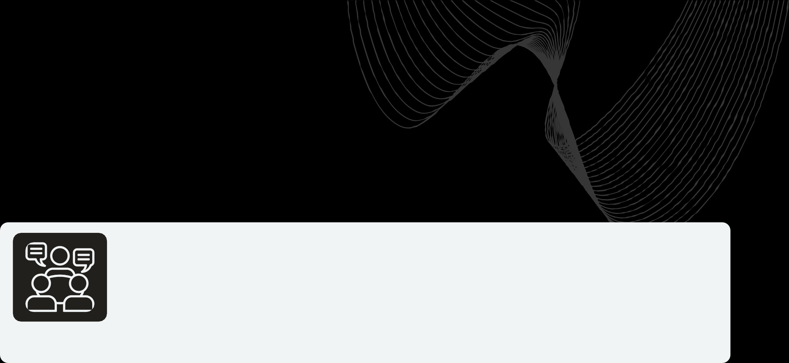

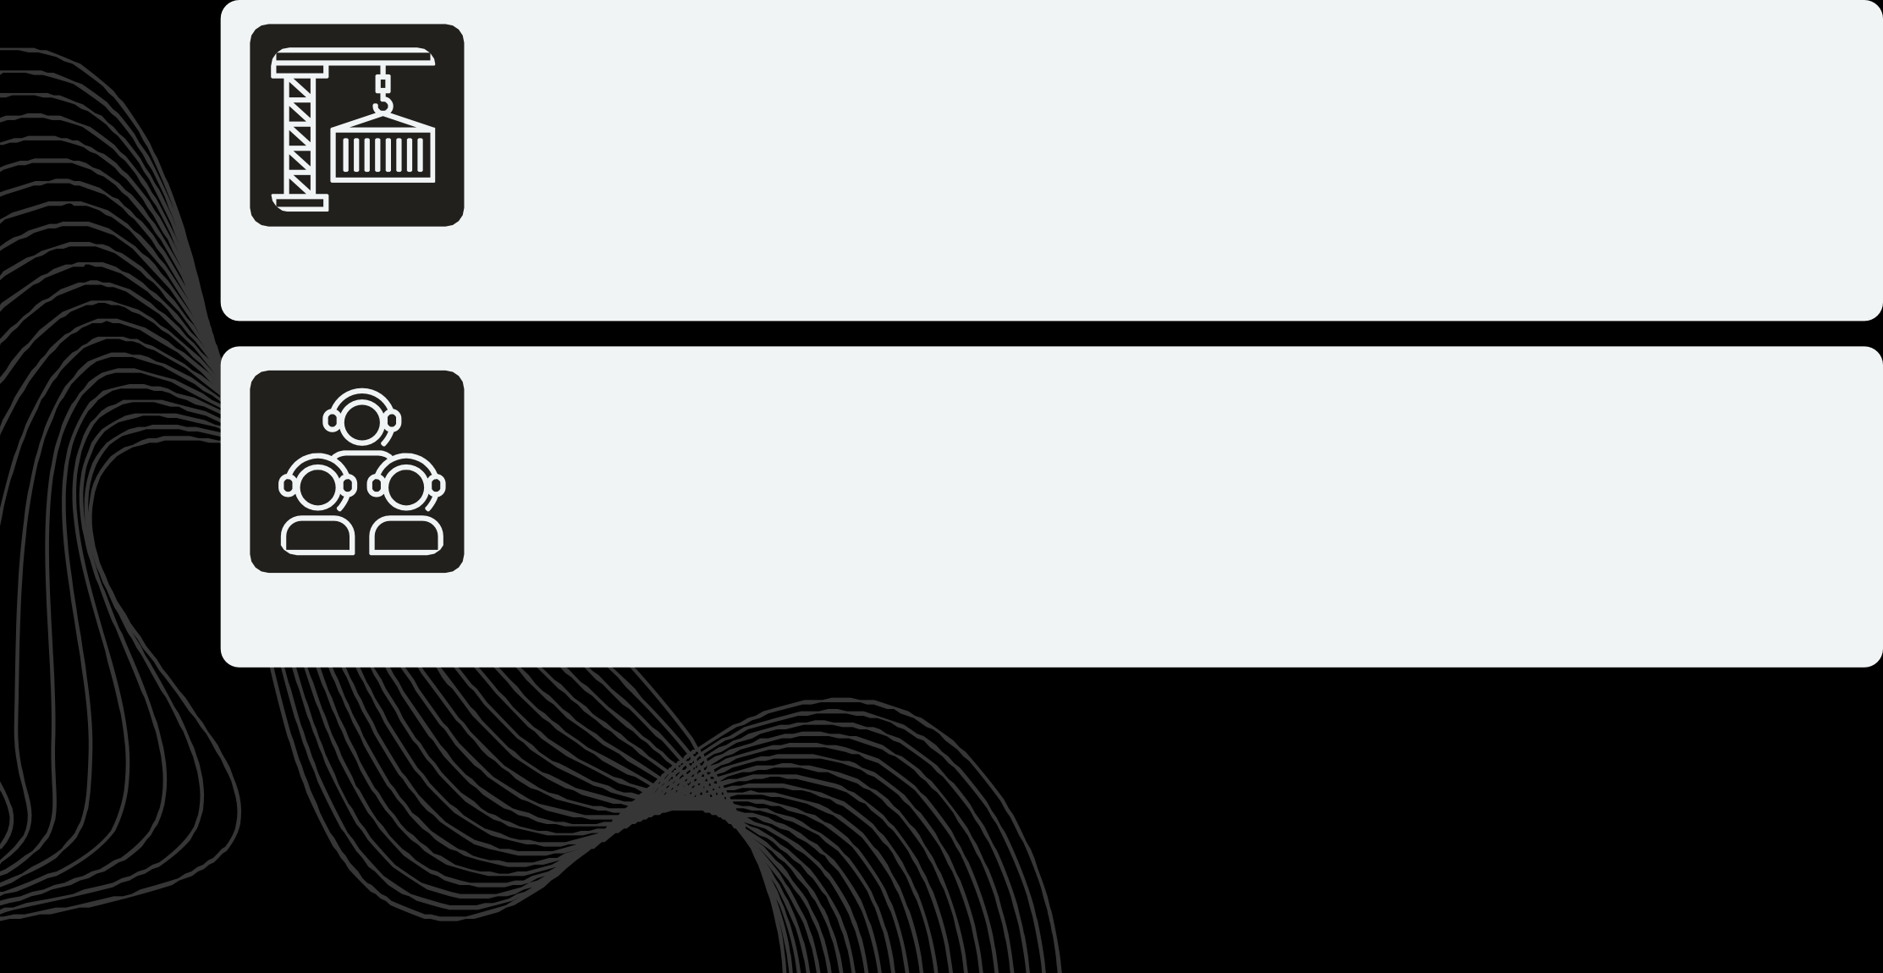
LOGIN
REGISTRATION
ONLINE BOOKING 4.BOOKING FORM 5.ONLINE TRANSACTION 6.FLIGHT STATUS
WEB CHECK -IN
CANCELRESERVATION

Slide 19
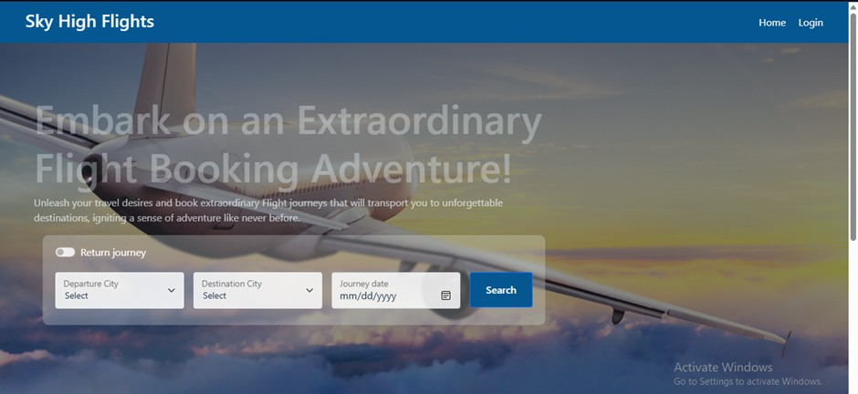
Landing Page

Slide 20
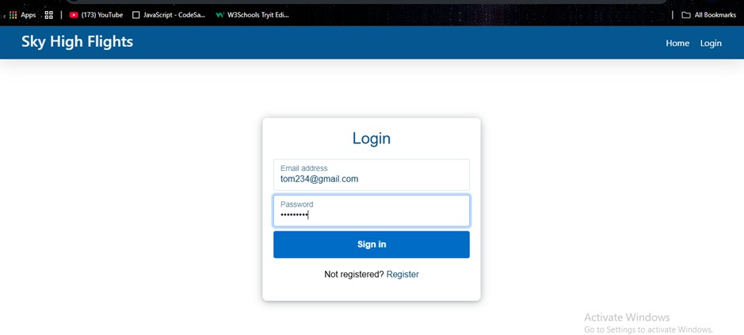
Login Page

Slide 21
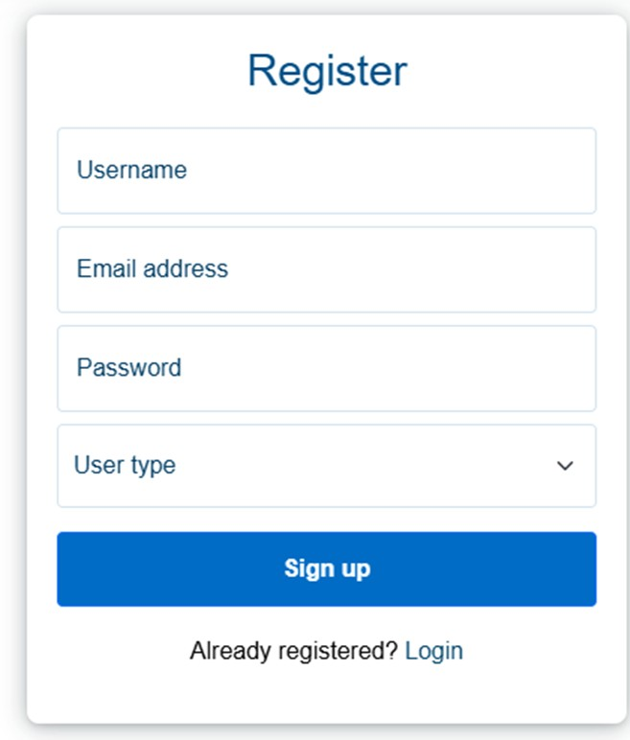
Register Page

Slide 22
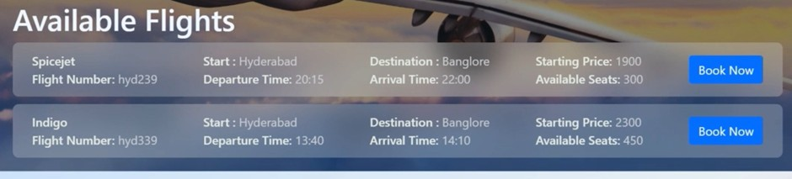
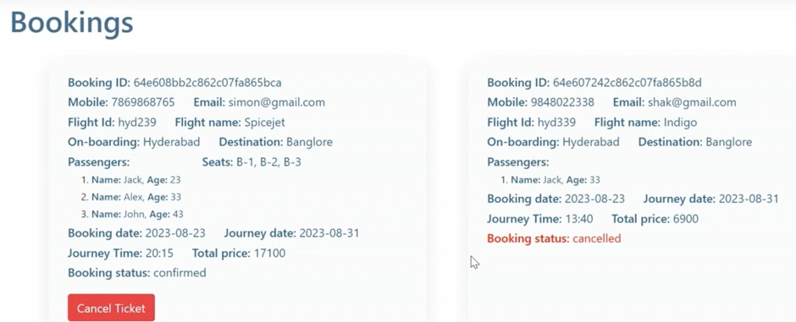
Work of a Customer

Slide 23
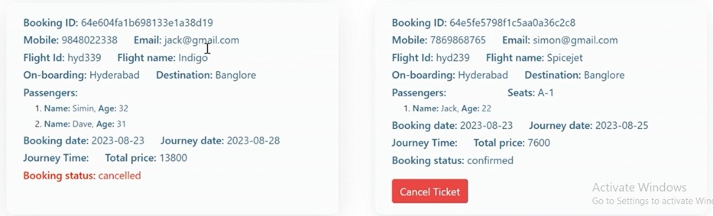
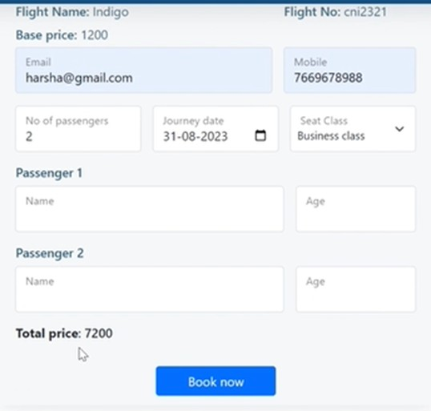
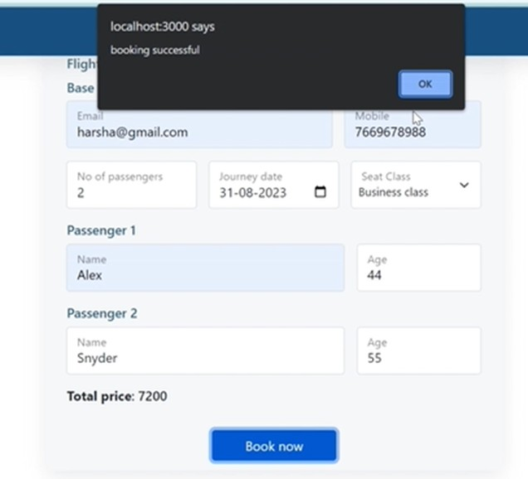

Slide 24
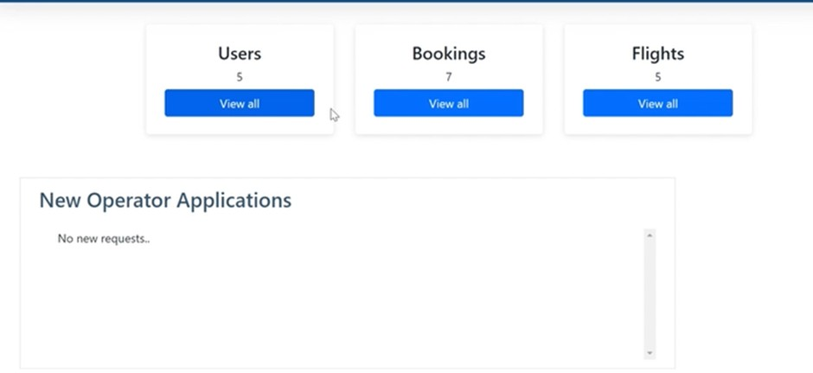
Work of Admin

Slide 25
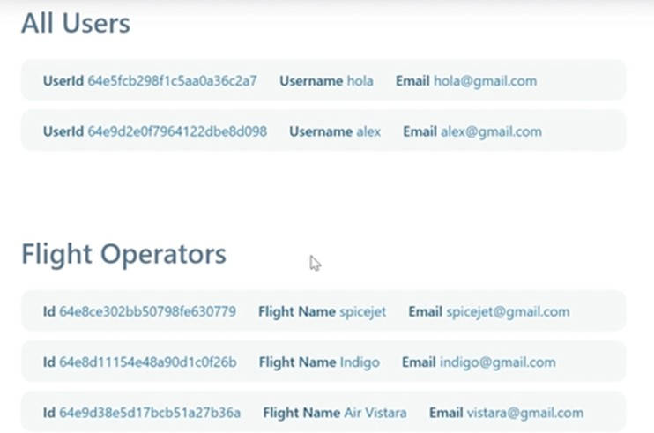
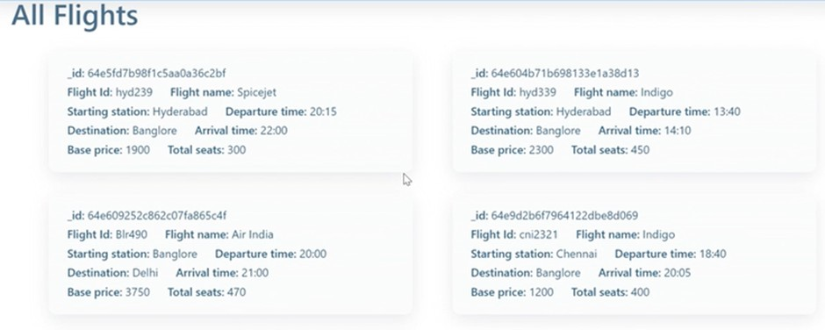

Slide 26
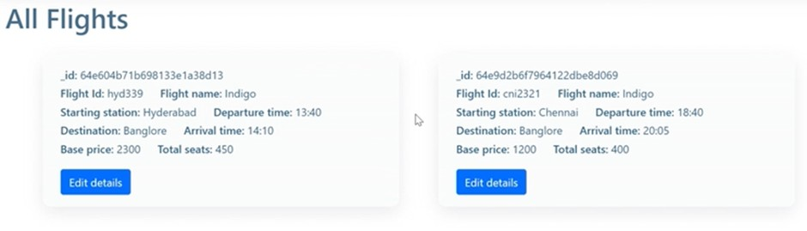
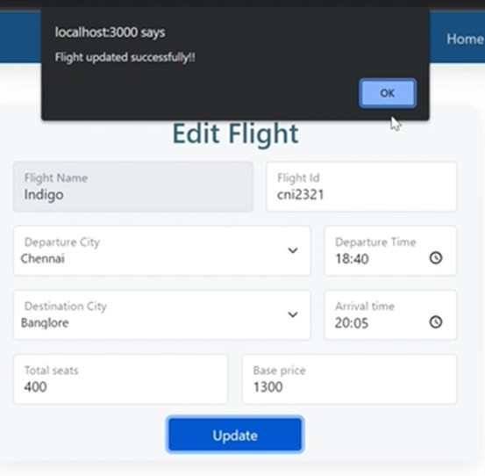
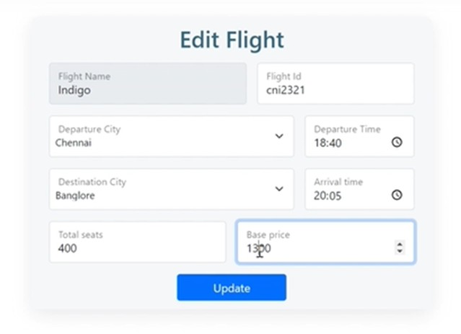
Working of a Flight Operator

Slide 27

Overall Journey for Building the Application:
Planning and Requirements Gathering Setting Up the Development Environment Backend Development (Express + MongoDB) Frontend Development (React) Implementing Additional Features
Testing and Debugging Deployment and Scaling
Post-Deployment and Monitoring

Slide 28

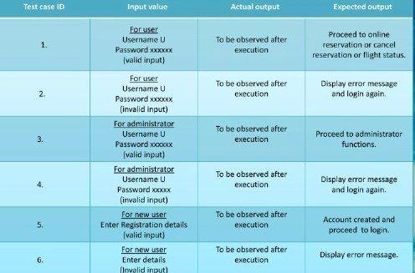
TEST CASES WE HAVE OBTAINED

Slide 29

Conclusion:
Building a flight booking application with the MERN stack involves careful planning, development, testing, and deployment. A structured approach ensures a robust application that meets user needs, from flight searches to secure bookings and payments. Each phase, from backend API setup to frontend integration, is essential for a seamless user experience.

Slide 30


T H A N K
Y O U
Gerente General

